Slide 1
Introduction to OOP
Various programming paradigms: Procedural, object-oriented, logic and functional, concurrent programming. Classes, Objects, Methods; Data types provided by OO languages; Abstract Data Types

Slide 2
Introduction
Java is one of the most popular and widely used programming languages.
Used to develop mobile apps, desktop apps, web apps, web servers, games, and enterprise-level systems.
Java was invented by James Gosling and Oracle currently owns it. JDK 23 is the latest version of Java.
Java's syntax is similar to C/C++.
Popular platforms like LinkedIn, Amazon, and Netflix rely on Java for their back-end architecture, showcasing its stability and scalability across different environments.
Popularity is so high that 3 Billion+ devices use Java across the world.

Slide 3
Java is a class-based, object-oriented programming language that is designed to have as few implementation dependencies as possible. It is intended to let application developers Write Once and Run Anywhere (WORA), meaning that compiled Java code can run on all platforms that support Java without the need for recompilation. Java was developed by James Gosling at Sun Microsystems Inc. in May 1995 and later acquired by Oracle Corporation and is widely used for developing applications for desktop, web, and mobile devices. Java is known for its simplicity, robustness, and security features, making it a popular choice for enterprise-level applications. Java applications are compiled to byte code that can run on any Java Virtual Machine. The syntax of Java is similar to C/C++.
Java makes writing, compiling, and debugging programming easy. It helps to create reusable code and modular programs.

Slide 4
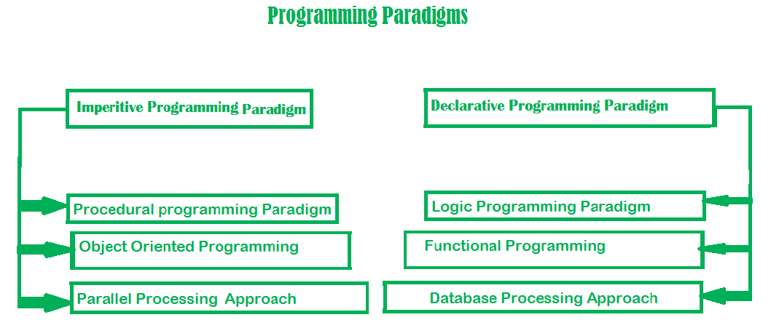

Slide 5
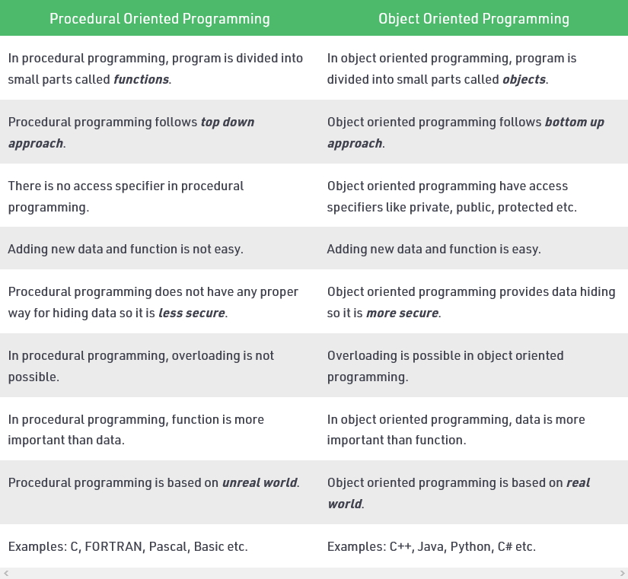

Slide 6
Key Features
1. Platform Independent
2. Object-Oriented Programming
3. Simplicity
4. Robustness
5. Security
6. Distributed
7. Multithreading
8. Portability
9. High Performance

Slide 7
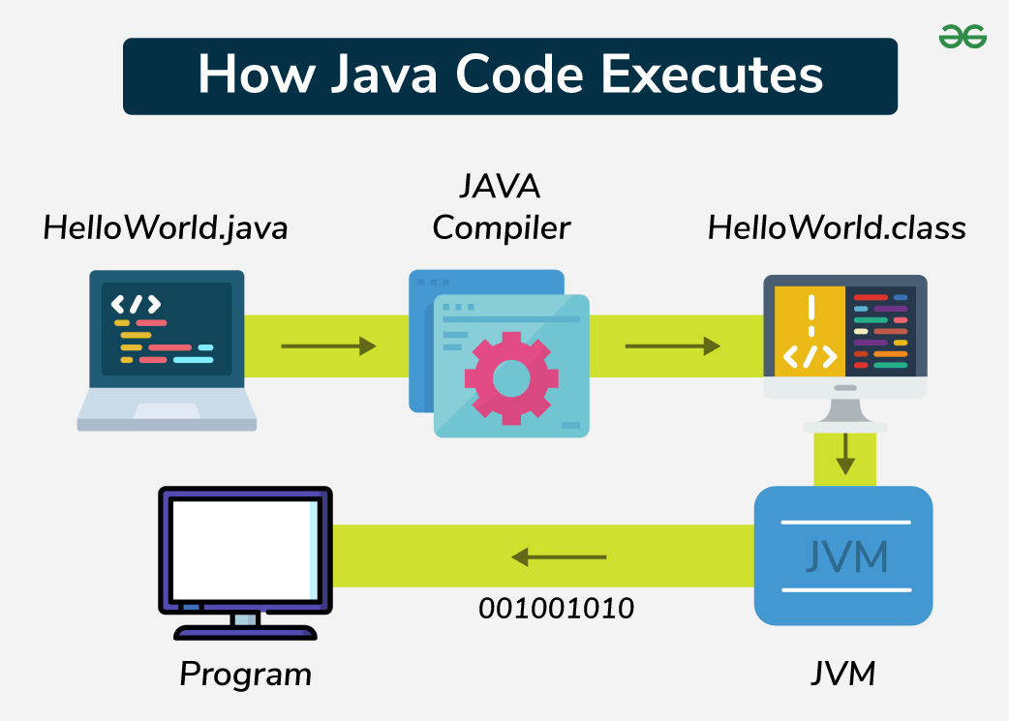
How java code executes?

Slide 8
1. Creating the Program
Java programs are written using a text editor or an Integrated Development Environment (IDE) like IntelliJ IDEA, Eclipse, or NetBeans. The source code is saved with a .java extension.
2. Compiling the Program
The Java compiler (javac) converts the source code into bytecode, which is stored in a .class file. This bytecode is platform-independent and can be executed on any machine with a JVM.
3. Running the Program
The JVM executes the compiled bytecode, translating it into machine code specific to the operating system and hardware.

Slide 9
Important Terminologies:
1. Java Virtual Machine(JVM)
The JVM is an integral part of the Java platform, responsible for executing Java bytecode. It ensures that the output of Java programs is consistent across different platforms.
Writing a program is done by a java programmer like you and me.
The compilation is done by the JAVAC compiler which is a primary Java compiler included in the Java development kit (JDK). It takes the Java program as input and generates bytecode as output.
In the Running phase of a program, JVM executes the bytecode generated by the compiler.
The Java Virtual Machine (JVM) is designed to run the bytecode generated by the Java compiler. Each operating system has its own version of the JVM, but all JVMs follow the same rules and standards. This means Java programs can run the same way on any device with a JVM, regardless of the operating system. This is why Java is called a platform-independent language.

Slide 10
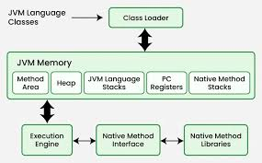
2. Bytecode
Bytecode is the intermediate representation of Java code, generated by the Java compiler. It is platform-independent and can be executed by the JVM.
3. Java Development Kit(JDK)
While we were using the term JDK when we learn about bytecode and JVM. So, as the name suggests, it is a complete Java development kit that includes everything including compiler, Java Runtime Environment (JRE), Java Debuggers, Java Docs, etc. For the program to execute in java, we need to install JDK on our computer in order to create, compile and run the java program.

Slide 11
4. Java Runtime Environment (JRE)
JDK includes JRE. JRE installation on our computers allows the java program to run, however, we cannot compile it. JRE includes a browser, JVM, applet support, and plugins. For running the java program, a computer needs JRE.
5. Garbage Collector
In Java, programmers can’t delete the objects. To delete or recollect that memory JVM has a program called Garbage Collector. Garbage Collectors can recollect the objects that are not referenced. So Java makes the life of a programmer easy by handling memory management. However, programmers should be careful about their code whether they are using objects that have been used for a long time. Because Garbage cannot recover the memory of objects being referenced.
6. ClassPath
The Classpath is the file path where the java runtime and Java compiler look for .class files to load. By default, JDK provides many libraries. If you want to include external libraries they should be added to the classpath.
Basically everything in java is represented in Class as an object including the main function.

Slide 12
Advantages of Java
Platform independent: Java code can run on any platform that has a Java Virtual Machine (JVM) installed, which means that applications can be written once and run on any device.
Object-Oriented: Java is an object-oriented programming language, which means that it follows the principles of encapsulation, inheritance, and polymorphism.
Security: Java has built-in security features that make it a secure platform for developing applications, such as automatic memory management and type checking.
Large community: Java has a large and active community of developers, which means that there is a lot of support available for learning and using the language.
Enterprise-level applications: Java is widely used for developing enterprise-level applications, such as web applications, e-commerce systems, and database systems.
Disadvantages of Java
Performance: Java can be slower compared to other programming languages, such as C++, due to its use of a virtual machine and automatic memory management.
Memory management: Java’s automatic memory management can lead to slower performance and increased memory usage, which can be a drawback for some applications.

Slide 13
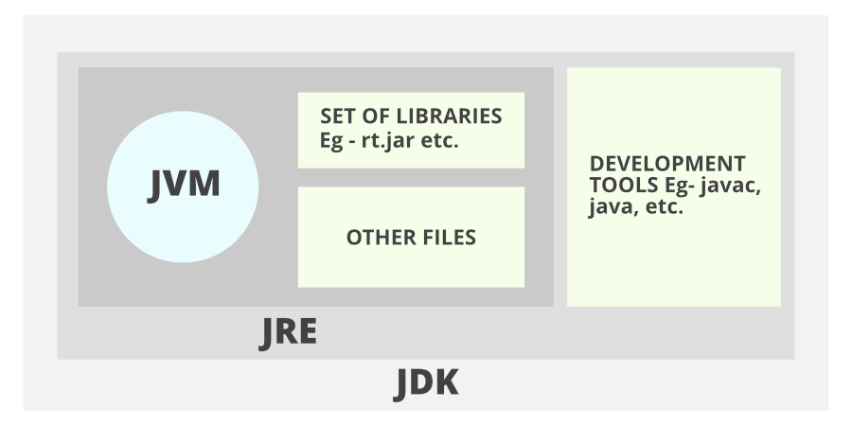

Slide 14
Java Syntax
Java is an object-oriented programming language which is known for its simplicity, portability, and robustness. The syntax of Java programming language is very closely aligned with C and C++ which makes it easier to understand.
A basic Java program consists of several components that create a functional application:
// FileName : “main.java".
public class main {
// Program begins with a call to main() method
public static void main(String args[])
{
// Prints "Hello World"
System.out.println("Hello World");
}
}

Slide 15
Terminologies of a Basic Java Program
1. Class: The class is a blueprint (plan) of the instance of a class (object). It can be defined as a logical template that share common properties and methods.
Example 1: Blueprint of the house is class.
Example 2: In real world, Alice is an object of the “Human” class.
2. Object: The object is an instance of a class. It is an entity that has behavior and state.
Example: Dog, Cat, Monkey etc. are the object of “Animal” class.
Behavior: Running on the road.
3. Method: The behavior of an object is the method.
Example: The fuel indicator indicates the amount of fuel left in the car.
4. Instance Variables: Every object has its own unique set of instance variables. The state of an object is generally created by the values that are assigned to these instance variables.

Slide 16
Basic Syntax:
1. Comments in Java
There are three types of comments in Java.
i. Single line Comment
// System.out.println("This is an comment.");
ii. Multi-line Comment
/* System.out.println("This is the first line comment."); System.out.println("This is the second line comment."); */
iii. Documentation Comment. Also called a doc comment.
/** documentation */
2. Source File Name
The name of a source file should exactly match the public class name with the extension of . java. The name of the file can be a different name if it does not have any public class. Assume you have a public class main.
main.java // valid syntax main.java // invalid syntax

Slide 17
3. Case Sensitivity
Java is a case-sensitive language, which means that the identifiers AB, Ab, aB , and ab are different in Java.
System.out.println("Hello World"); // valid syntax system.out.println("Hello World"); // invalid syntax because of the first letter of System keyword is always uppercase.
4. Class Names
The first letter of the class should be in Uppercase (lowercase is allowed but discouraged).
If several words are used to form the name of the class, each inner word’s first letter should be in Uppercase. Underscores are allowed, but not recommended. Also allowed are numbers and currency symbols, although the latter are also discouraged because they are used for a special purpose (for inner and anonymous classes).
class MyJavaProgram // valid syntax class 1Program // invalid syntax class My1Program // valid syntax class $Program // valid syntax, but discouraged class My$Program // valid syntax, but discouraged (inner class Program inside the class My) class myJavaProgram // valid syntax, but discouraged

Slide 18
5. public static void main(String [] args)
The method main() is the main entry point into a Java program; this is where the processing starts. Also allowed is the signature public static void main(String… args) .
6. Method Names
All the method names should start with a lowercase letter (uppercase is also allowed but lowercase is recommended).
If several words are used to form the name of the method, then each first letter of the inner word should be in Uppercase. Underscores are allowed, but not recommended. Also allowed are digits and currency symbols.
public void employeeRecords() // valid syntax public void EmployeeRecords() // valid syntax, but discouraged
7. White spaces in Java
A line containing only white spaces, possibly with the comment, is known as a blank line, and the Java compiler totally ignores it.

Slide 19
8. Identifiers in Java
Identifiers are the names of local variables, instance and class variables, and labels, but also the names for classes, packages, modules and methods. All Unicode characters are valid, not just the ASCII subset.
All identifiers can begin with a letter, a currency symbol or an underscore ( _ ). According to the convention, a letter should be lower case for variables.
The first character of identifiers can be followed by any combination of letters, digits, currency symbols and the underscore. The underscore is not recommended for the names of variables. Constants (static final attributes and enums) should be in all Uppercase letters.
Most importantly identifiers are case-sensitive.
A keyword cannot be used as an identifier since it is a reserved word and has some special meaning.
Legal identifiers: MinNumber, total, ak74, hello_world, $amount, _under_value Illegal identifiers: 74ak, -amount

Slide 20
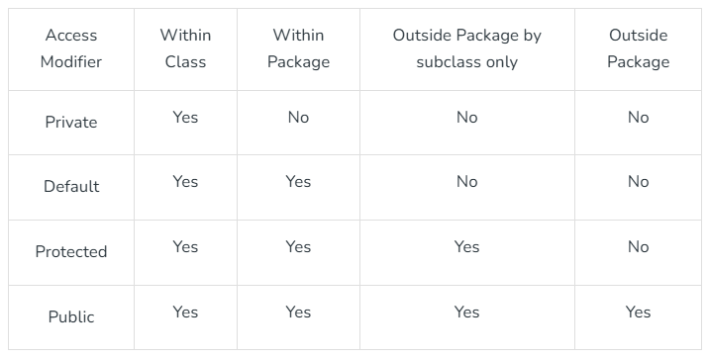
9. Access Modifiers
These modifiers control the scope of class and methods.
Access Modifiers: default, public, protected, private.
Non-access Modifiers: final, abstract, static, transient, synchronized, volatile, native.
Access ModifierWithin ClassWithin PackageOutside Package by subclass onlyOutside PackagePrivateYes

Slide 21
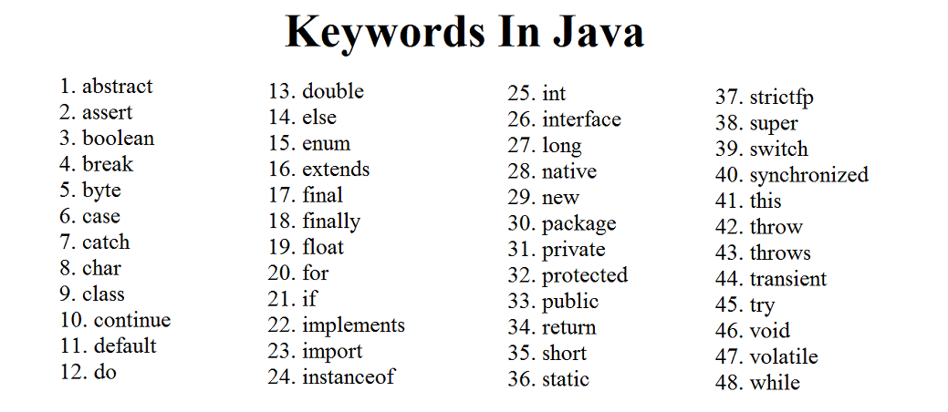
10. Java Keywords
Keywords or Reserved words are the words in a language that are used for some internal process or represent some predefined actions. These words are therefore not allowed to use as variable names or objects.

Slide 22
Java Helloworld Program
// This is a simple Java program.
// FileName : "HelloWorld.java".
class HelloWorld {
// Your program begins with a call to main().
// Prints "Hello, World" to the terminal window.
public static void main(String[] args)
{
System.out.println("Hello, World");
}
}

Slide 23
Main Method:
In the Java programming language, every application must contain a main method. The main function(method) is the entry point of your Java application, and it’s mandatory in a Java program. whose signature in Java is:
public static void main(String[] args)
Explanation of the above syntax
public : So that JVM can execute the method from anywhere.
static : The main method is to be called without an object. The modifiers are public and static can be written in either order.
void : The main method doesn’t return anything.
main() : Name configured in the JVM. The main method must be inside the class definition. The compiler executes the codes starting always from the main function.
String[] : The main method accepts a single argument, i.e., an array of elements of type String.

Slide 24
Identifiers:
An identifier in Java is the name given to Variables, Classes, Methods, Packages, Interfaces, etc. These are the unique names and every Java Variables must be identified with unique names.
Example:
public class Test { public static void main(String[] args) { int a = 20; } }
In the above Java code, we have 5 identifiers as follows:
Test: Class Name
main: Method Name
String: Predefined Class Name
args: Variable Name
a: Variable Name

Slide 25
Rules For Naming Java Identifiers
There are certain rules for defining a valid Java identifier. These rules must be followed, otherwise, we get a compile-time error. These rules are also valid for other languages like C, and C++.
The only allowed characters for identifiers are all alphanumeric characters([A-Z],[a-z],[0-9]), ‘$‘(dollar sign) and ‘_‘ (underscore). For example “geek@” is not a valid Java identifier as it contains a ‘@’ a special character.
Identifiers should not start with digits([0-9]). For example “123geeks” is not a valid Java identifier.
Java identifiers are case-sensitive.
There is no limit on the length of the identifier but it is advisable to use an optimum length of 4 – 15 letters only.
Reserved Words can’t be used as an identifier. For example “int while = 20;” is an invalid statement as a while is a reserved word. There are 53 reserved words in Java.

Slide 26
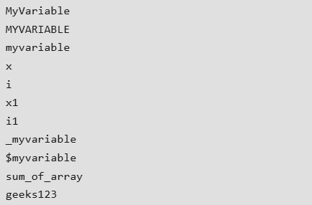
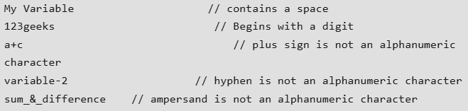
Examples of Valid Identifiers:
Examples of Invalid Identifiers:

Slide 27
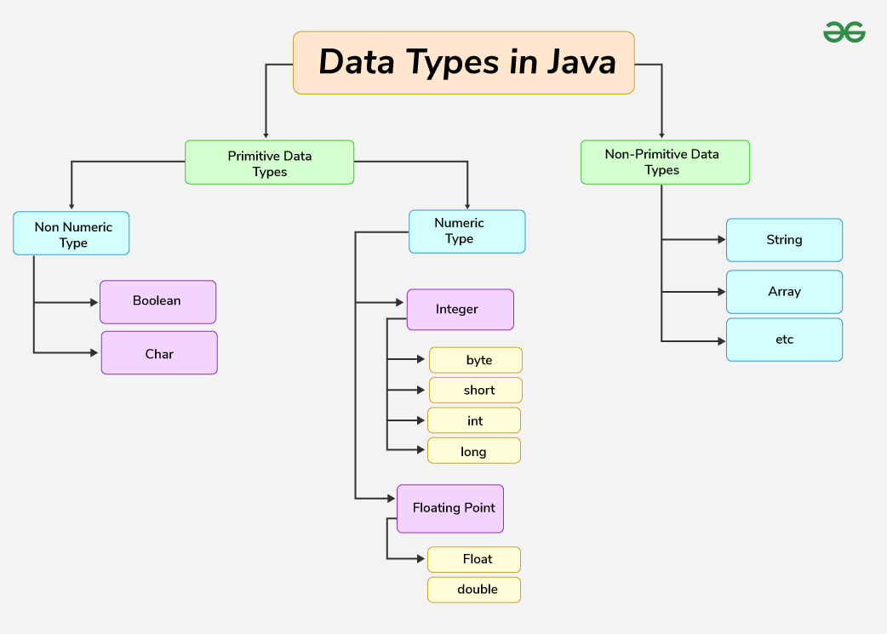
Data Types: Java is statically typed and also a strongly typed language because, in Java, each type of data (such as integer, character, hexadecimal, packed decimal, and so forth) is predefined as part of the programming language and all constants or variables defined for a given program must be described with one of the Java data types.

Slide 28
Data types in Java are of different sizes and values that can be stored in the variable that is made as per convenience and circumstances to cover up all test cases. Java has two categories in which data types are segregated
Primitive Data Type: such as boolean, char, int, short, byte, long, float, and double. The Boolean with uppercase B is a wrapper class for the primitive data type boolean in Java.
Non-Primitive Data Type or Object Data type: such as String, Array, etc.
// Java Program to demonstrate int data-type
import java.io.*;
class main
{
public static void main (String[] args)
{
// declaring two int variables
int a = 10;
int b = 20;
System.out.println( a + b );
}
}

Slide 29
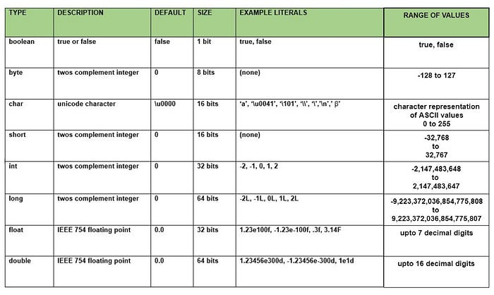

Slide 30
Primitive Data Types
1. boolean Data Type
The boolean data type represents a logical value that can be either true or false. Conceptually, it represents a single bit of information, but the actual size used by the virtual machine is implementation-dependent and typically at least one byte (eight bits) in practice. Values of the boolean type are not implicitly or explicitly converted to any other type using casts. However, programmers can write conversion code if needed.
Syntax:
boolean booleanVar;Size : Virtual machine dependent (typically 1 byte, 8 bits)
2. byte Data Type
The byte data type is an 8-bit signed two’s complement integer. The byte data type is useful for saving memory in large arrays.
Syntax:
byte byteVar;Size : 1 byte (8 bits)

Slide 31
3. short Data Type
The short data type is a 16-bit signed two’s complement integer. Similar to byte, a short is used when memory savings matter, especially in large arrays where space is constrained.
Syntax:
short shortVar;Size : 2 bytes (16 bits)
4. int Data Type
It is a 32-bit signed two’s complement integer.
Syntax:
int intVar;Size : 4 bytes ( 32 bits )
5. long Data Type
The long data type is a 64-bit signed two’s complement integer. It is used when an int is not large enough to hold a value, offering a much broader range.
Syntax:
long longVar;Size : 8 bytes (64 bits)

Slide 32
6. float Data Type
The float data type is a single-precision 32-bit IEEE 754 floating-point. Use a float (instead of double) if you need to save memory in large arrays of floating-point numbers. The size of the float data type is 4 bytes (32 bits).
Syntax:
float floatVar;Size : 4 bytes (32 bits)
7. double Data Type
The double data type is a double-precision 64-bit IEEE 754 floating-point. For decimal values, this data type is generally the default choice. The size of the double data type is 8 bytes or 64 bits.
Syntax:
double doubleVar;Size : 8 bytes (64 bits)
8. char Data Type
The char data type is a single 16-bit Unicode character with the size of 2 bytes (16 bits).
Syntax:
char charVar;Size : 2 bytes (16 bits)

Slide 33
Non-Primitive (Reference) Data Types
The Non-Primitive (Reference) Data Types will contain a memory address of variable values because the reference types won’t store the variable value directly in memory. They are strings, objects, arrays, etc.
1. Strings
Strings are defined as an array of characters. The difference between a character array and a string in Java is, that the string is designed to hold a sequence of characters in a single variable whereas, a character array is a collection of separate char-type entities. Unlike C/C++, Java strings are not terminated with a null character.
Syntax: Declaring a string
<String_Type> <string_variable> = “<sequence_of_string>”;
Example:
// Declare String without using new operator String s = “Hello"; // Declare String using new operator String s1 = new String(“Hello");

Slide 34
2. Class
A Class is a user-defined blueprint or prototype from which objects are created. It represents the set of properties or methods that are common to all objects of one type. In general, class declarations can include these components, in order:
Modifiers : A class can be public or has default access. Refer to access specifiers for classes or interfaces in Java
Class name: The name should begin with an initial letter (capitalized by convention).
Superclass(if any): The name of the class’s parent (superclass), if any, preceded by the keyword extends. A class can only extend (subclass) one parent.
Interfaces(if any): A comma-separated list of interfaces implemented by the class, if any, preceded by the keyword implements. A class can implement more than one interface.
Body: The class body is surrounded by braces, { }.

Slide 35
3. Object
An Object is a basic unit of Object-Oriented Programming and represents real-life entities. A typical Java program creates many objects, which as you know, interact by invoking methods. An object consists of :
State : It is represented by the attributes of an object. It also reflects the properties of an object.
Behavior : It is represented by the methods of an object. It also reflects the response of an object to other objects.
Identity : It gives a unique name to an object and enables one object to interact with other objects.
4. Interface
Like a class, an interface can have methods and variables, but the methods declared in an interface are by default abstract (only method signature, no body).
Interfaces specify what a class must do and not how. It is the blueprint of the class.
An Interface is about capabilities like a Player may be an interface and any class implementing Player must be able to (or must implement) move(). So it specifies a set of methods that the class has to implement.
If a class implements an interface and does not provide method bodies for all functions specified in the interface, then the class must be declared abstract.
A Java library example is Comparator Interface . If a class implements this interface, then it can be used to sort a collection.

Slide 36
5. Array
An Array is a group of like-typed variables that are referred to by a common name. Arrays in Java work differently than they do in C/C++. The following are some important points about Java arrays.
In Java, all arrays are dynamically allocated. (discussed below)
Since arrays are objects in Java, we can find their length using member length. This is different from C/C++ where we find length using size.
A Java array variable can also be declared like other variables with [] after the data type.
The variables in the array are ordered and each has an index beginning with 0.
Java array can also be used as a static field, a local variable, or a method parameter.
The size of an array must be specified by an int value and not long or short.
The direct superclass of an array type is Object.
Every array type implements the interfaces Cloneable and java.io.Serializable.

Slide 37
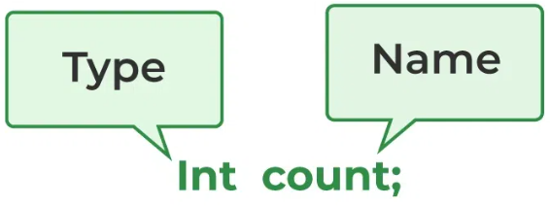
Variables:
Variables are the containers for storing the data values or you can also call it a memory location name for the data. Every variable has a:
Data Type – The kind of data that it can hold. For example, int, string, float, char, etc.
Variable Name – To identify the variable uniquely within the scope.
Value – The data assigned to the variable.
There are three types of variables in Java – Local, Instance, and Static.
Example: int age = 27; // integer variable having value 27 String name = "gfg" // string variable
How to declare the variable:
From the image, it can be easily perceived that while declaring a variable, we need to take care of two things that are:
datatype: In Java, a data type define the type of data that a variable can hold.
data_name: Name was given to the variable.
In this way, a name can only be given to a memory location. It can be assigned values in two ways:
Variable Initialization
Assigning value by taking input

Slide 38
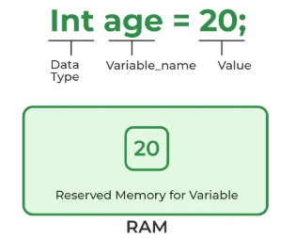
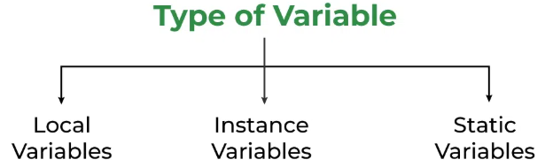
How to Initialize Java Variables?
It can be perceived with the help of 3 components explained above:
Example:
// Declaring float variable float simpleInterest; // Declaring and initializing integer variable int time = 10, speed = 20; // Declaring and initializing character variable char var = 'h';
Types of Java Variables
Now let us discuss different types of variables which are listed as follows:
Local Variables
Instance Variables
Static Variables

Slide 39
1. Local Variables
A variable defined within a block or method or constructor is called a local variable.
The Local variable is created at the time of declaration and destroyed after exiting from the block or when the call returns from the function.
The scope of these variables exists only within the block in which the variables are declared, i.e., we can access these variables only within that block.
Initialization of the local variable is mandatory before using it in the defined scope.
// Java Program to show the use of local variables
import java.io.*;
class main {
public static void main(String[] args)
{
// Declared a Local Variable
int var = 10;
// This variable is local to this main method only
System.out.println("Local Variable: " + var);
}
}

Slide 40
2. Instance Variables
Instance variables are non-static variables and are declared in a class outside of any method, constructor, or block.
As instance variables are declared in a class, these variables are created when an object of the class is created and destroyed when the object is destroyed.
Unlike local variables, we may use access specifiers for instance variables. If we do not specify any access specifier, then the default access specifier will be used.
Initialization of an instance variable is not mandatory. Its default value is dependent on the data type of variable. For String it is null, for float it is 0.0f, for int it is 0, for Wrapper classes like Integer it is null, etc.
Scope of instance variables are throughout the class except the static contexts.
Instance variables can be accessed only by creating objects.
We initialize instance variables using constructors while creating an object. We can also use instance blocks to initialize the instance variables.

Slide 41
// Java Program to show the use of
// Instance Variables
import java.io.*;
class main {
// Declared Instance Variable
public String Name;
public int i;
public Integer I;
public main()
{
// Default Constructor
// initializing Instance Variable
this.Name = "Shubham Jain";
}
// Main Method
public static void main(String[] args)
{
// Object Creation
main name = new main();
// Displaying O/P
System.out.println(“Person name is: " + name.Name);
System.out.println("Default value for int is "+ name.i);
// toString() called internally
System.out.println("Default value for Integer is "+ name.I);
}
}

Slide 42
3. Static Variables
Static variables are also known as class variables.
These variables are declared similarly to instance variables. The difference is that static variables are declared using the static keyword within a class outside of any method, constructor, or block.
Unlike instance variables, we can only have one copy of a static variable per class, irrespective of how many objects we create.
Static variables are created at the start of program execution and destroyed automatically when execution ends.
Initialization of a static variable is not mandatory. Its default value is dependent on the data type of variable. For String it is null, for float it is 0.0f, for int it is 0, for Wrapper classes like Integer it is null, etc.
If we access a static variable like an instance variable (through an object), the compiler will show a warning message, which won’t halt the program. The compiler will replace the object name with the class name automatically.
If we access a static variable without the class name, the compiler will automatically append the class name. But for accessing the static variable of a different class, we must mention the class name as 2 different classes might have a static variable with the same name.
Static variables cannot be declared locally inside an instance method.

Slide 43
// Java Program to show the use of
// Static variables
import java.io.*;
class main {
// Declared static variable
public static String Name = "Shubham Jain";
public static void main(String[] args)
{
// geek variable can be accessed without object
// creation Displaying O/P GFG.geek --> using the
// static variable
System.out.println("Geek Name is : " + GFG.geek);
// static int c = 0;
// above line, when uncommented,
// will throw an error as static variables cannot be
// declared locally.
}
}

Slide 44
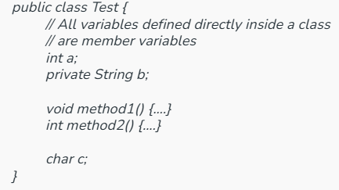
Scope of Variables
The scope of variables is the part of the program where the variable is accessible. Like C/C++, in Java, all identifiers are lexically (or statically) scoped, i.e. scope of a variable can be determined at compile time and independent of the function call stack.
Java Scope of Variables
Java Scope Rules can be covered under the following categories.
1. Instance Variables – Class Level Scope
These variables must be declared inside class (outside any function). They can be directly accessed anywhere in class.
We can declare class variables anywhere in class,
but outside methods.
Access specified of member variables doesn’t
affect scope of them within a class.
Member variables can be accessed outside a class.

Slide 45
2. Static Variables – Class Level Scope
Static Variable is a type of class variable shared across instances. Static Variables are the variables which once declared can be used anywhere even outside the class without initializing the class. Unlike Local variables it scope is not limited to the class or the block.
// Using Static variables
import java.io.*;
class Test{
// static variable in Test class
static int var = 10;
}
class Geeks
{
public static void main (String[] args) {
// accessing the static variable
System.out.println("Static Variable : "+Test.var);
}
}

Slide 46
3. Method Level Scope – Local Variable
Variables declared inside a method have method level scope and can’t be accessed outside the method.
public class Test { void method1() { // Local variable (Method level scope) int x; }}
Note: Local variables don’t exist after method’s execution is over.
4. Parameter Scope – Local Variable
Here’s another example of method scope, except this time the variable got passed in as a parameter to the method:
class Test { private int x; public void setX(int x) { this.x = x; }}

Slide 47
5. Block Level Scope
A variable declared inside pair of brackets “{” and “}” in a method has scope within the brackets only.
// Using Block Scope
public class Test
{ public static void main(String args[])
{
// Block Level Scope
{ // The variable x has scope within brackets
int x = 10;
System.out.println(x);
}
// Uncommenting below line would produce error since variable x is out of scope.
// System.out.println(x);
}
}

Slide 48
Java Operators: Java operators are special symbols that perform operations on variables or values. They can be classified into several categories based on their functionality. These operators play a crucial role in performing arithmetic, logical, relational, and bitwise operations etc.
/ /Java program to show the use of + and - operators
public class Operator
{
public static void main(String[] args)
{
// Declare and initialize variables
int num1 = 500;
int num2 = 100;
// Using the + (addition) operator
int sum = num1 + num2;
System.out.println("The Sum is: "+sum);
// Using the - (subtraction) operator
int diff = num1 - num2;
System.out.println("The Difference is: "+diff);
}
}

Slide 49
Types of Operators in Java
Arithmetic Operators
Unary Operators
Assignment Operator
Relational Operators
Logical Operators
Ternary Operator
Bitwise Operators
Shift Operators
instance of operator
1. Arithmetic Operators
Arithmetic Operators are used to perform simple arithmetic operations on primitive and non-primitive data types.
* : Multiplication
/ : Division
% : Modulo
+ : Addition
– : Subtraction

Slide 50
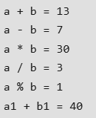
// Java Program to show the use of Arithmetic Operators
import java.io.*;
class Operator
{
public static void main (String[] args)
{
// Arithmetic operators on integers
int a = 10;
int b = 3;
// Arithmetic operators on Strings
String n1 = "15";
String n2 = "25";
// Convert Strings to integers
int a1 = Integer.parseInt(n1);
int b1 = Integer.parseInt(n2);
System.out.println("a + b = " + (a + b));
System.out.println("a - b = " + (a - b));
System.out.println("a * b = " + (a * b));
System.out.println("a / b = " + (a / b));
System.out.println("a % b = " + (a % b));
System.out.println("a1 + b1 = " + (a1 + b1));
}
}

Slide 51
2. Unary Operators
Unary Operators need only one operand. They are used to increment, decrement, or negate a value.
- , Negates the value.
+ , Indicates a positive value (automatically converts byte, char, or short to int).
++ , Increments by 1.
Post-Increment: Uses value first, then increments.
Pre-Increment: Increments first, then uses value.
-- , Decrements by 1.
Post-Decrement: Uses value first, then decrements.
Pre-Decrement: Decrements first, then uses value.
! , Inverts a boolean value.

Slide 52
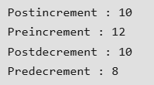
// Java Program to show the use of Unary Operators
import java.io.*;
// Driver Class
class UnaryO {
// main function
public static void main(String[] args)
{
// Interger declared
int a = 10;
int b = 10;
// Using unary operators
System.out.println("Postincrement : " + (a++));
System.out.println("Preincrement : " + (++a));
System.out.println("Postdecrement : " + (b--));
System.out.println("Predecrement : " + (--b));
}
}

Slide 53
3. Assignment Operator
‘=’ Assignment operator is used to assign a value to any variable. It has right-to-left associativity, i.e. value given on the right-hand side of the operator is assigned to the variable on the left, and therefore right-hand side value must be declared before using it or should be a constant.
The general format of the assignment operator is:
variable = value;
In many cases, the assignment operator can be combined with others to create shorthand compound statements. For example, a += 5 replaces a = a + 5. Common compound operators include:
+= , Add and assign.
-= , Subtract and assign.
*= , Multiply and assign.
/= , Divide and assign.
%= , Modulo and assign.

Slide 54
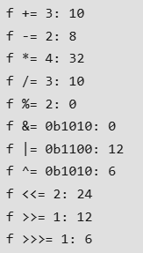
// Java Program to show the use of Assignment Operators
import java.io.*;
// Driver Class
class Assign {
// Main Function
public static void main(String[] args)
{
// Assignment operators
int f = 7;
System.out.println("f += 3: " + (f += 3));
System.out.println("f -= 2: " + (f -= 2));
System.out.println("f *= 4: " + (f *= 4));
System.out.println("f /= 3: " + (f /= 3));
System.out.println("f %= 2: " + (f %= 2));
System.out.println("f &= 0b1010: " + (f &= 0b1010));
System.out.println("f |= 0b1100: " + (f |= 0b1100));
System.out.println("f ^= 0b1010: " + (f ^= 0b1010));
System.out.println("f <<= 2: " + (f <<= 2));
System.out.println("f >>= 1: " + (f >>= 1));
System.out.println("f >>>= 1: " + (f >>>= 1));
}
}

Slide 55
4. Relational Operators
Relational Operators are used to check for relations like equality, greater than, and less than. They return boolean results after the comparison and are extensively used in looping statements as well as conditional if-else statements. The general format is ,
variable relation_operator value
Relational operators compare values and return boolean results:
== , Equal to.
!= , Not equal to.
< , Less than.
<= , Less than or equal to.
> , Greater than.
>= , Greater than or equal to.

Slide 56
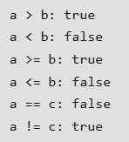
// Java Program to show the use of Relational Operators
import java.io.*;
// Driver Class
class Relation {
// main function
public static void main(String[] args)
{
// Comparison operators
int a = 10;
int b = 3;
int c = 5;
System.out.println("a > b: " + (a > b));
System.out.println("a < b: " + (a < b));
System.out.println("a >= b: " + (a >= b));
System.out.println("a <= b: " + (a <= b));
System.out.println("a == c: " + (a == c));
System.out.println("a != c: " + (a != c));
}
}

Slide 57

5. Logical Operators
Logical Operators are used to perform “logical AND” and “logical OR” operations, similar to AND gate and OR gate in digital electronics. They have a short-circuiting effect, meaning the second condition is not evaluated if the first is false.
Conditional operators are:
&&, Logical AND: returns true when both conditions are true.
||, Logical OR: returns true if at least one condition is true.
!, Logical NOT: returns true when a condition is false and vice-versa
// Java Program to show the use of Logical operators
import java.io.*;
class Logic {
// Main Function
public static void main (String[] args) {
// Logical operators
boolean x = true;
boolean y = false;
System.out.println("x && y: " + (x && y));
System.out.println("x || y: " + (x || y));
System.out.println("!x: " + (!x));
}
}

Slide 58

6. Ternary operator
The Ternary Operator is a shorthand version of the if-else statement. It has three operands and hence the name Ternary. The general format is ,
condition ? if true : if false
The above statement means that if the condition evaluates to true, then execute the statements after the ‘?’ else execute the statements after the ‘:’.
// Java program to illustrate max of three numbers using ternary operator.
public class Ternary {
public static void main(String[] args)
{
int a = 20, b = 10, c = 30, result;
// result holds max of three
// numbers
result = ((a > b) ? (a > c) ? a : c : (b > c) ? b : c);
System.out.println("Max of three numbers = "+ result);
}
}

Slide 59
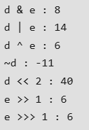
7. Bitwise Operators
Bitwise Operators are used to perform the manipulation of individual bits of a number and with any of the integer types. They are used when performing update and query operations of the Binary indexed trees.
& (Bitwise AND) – returns bit-by-bit AND of input values.
| (Bitwise OR) – returns bit-by-bit OR of input values.
^ (Bitwise XOR) – returns bit-by-bit XOR of input values.
~ (Bitwise Complement) – inverts all bits (one’s complement).
// Java Program to show the use of bitwise operators
import java.io.*;
class Bitwise
{
public static void main(String[] args)
{
// Bitwise operators
int d = 0b1010;
int e = 0b1100;
System.out.println("d & e : " + (d & e));
System.out.println("d | e : " + (d | e));
System.out.println("d ^ e : " + (d ^ e));
System.out.println("~d : " + (~d));
System.out.println("d << 2 : " + (d << 2));
System.out.println("e >> 1 : " + (e >> 1));
System.out.println("e >>> 1 : " + (e >>> 1));
}
}

Slide 60

8. Shift Operators
Shift Operators are used to shift the bits of a number left or right, thereby multiplying or dividing the number by two, respectively. They can be used when we have to multiply or divide a number by two. The general format , number shift_op number_of_places_to_shift;
<< (Left shift) – Shifts bits left, filling 0s (multiplies by a power of two).
>> (Signed right shift) – Shifts bits right, filling 0s (divides by a power of two), with the leftmost bit depending on the sign.
>>> (Unsigned right shift) – Shifts bits right, filling 0s, with the leftmost bit always 0.
// Java Program to show the use of shift operators
import java.io.*;
class Shift
{
public static void main(String[] args)
{
int a = 10;
// Using left shift
System.out.println("a<<1 : " + (a << 1));
// Using right shift
System.out.println("a>>1 : " + (a >> 1));
}
}

Slide 61
Precedence and Associativity of Java Operators
Precedence and associative rules are used when dealing with hybrid equations involving more than one type of operator. In such cases, these rules determine which part of the equation to consider first, as there can be many different valuations for the same equation. The below table depicts the precedence of operators in decreasing order as magnitude, with the top representing the highest precedence and the bottom showing the lowest precedence.

Slide 62
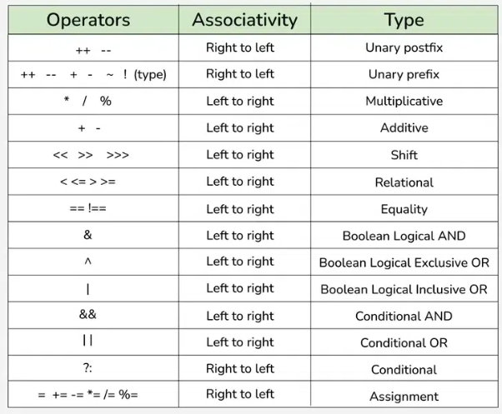

Slide 63
Java User Input: The most common way to take user input in Java is using Scanner class which is part of java.util package. The scanner class can read input from various sources like console, files or streams. This class was introduced in Java 5. Before that we use BufferedReader class(Introduced in Java 1.1).
Follow these steps to take user input using Scanner class:
Import the Scanner class using import java.util.Scanner;
Create the Scanner object and connect Scanner with System.in by passing it as an argument i.e. Scanner scn = new Scanner(System.in);
Print a message to prompt for user input and you can use the various methods of Scanner class like nextInt(), nextLine(), next(), nextDouble etc according to your need.

Slide 64
// taking user input import java.util.Scanner;
class Main
{
public static void main(String[] args)
{
// Creating Scanner class object
Scanner scn = new Scanner(System.in);
// Enter first input
System.out.print("Enter First Number: ");
int a = scn.nextInt();
System.out.print("Enter Second Number: ");
int b = scn.nextInt();
System.out.println("Sum: " + (a + b));
// Closing the scanner to release resources
scn.close();
}
}

Slide 65
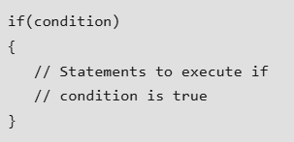
Flow Statements
if statement: The Java if statement is the most simple decision-making statement. It is used to decide whether a certain statement or block of statements will be executed or not i.e. if a certain condition is true then a block of statements is executed otherwise not.
// Java program to illustrate If statement
class Main {
public static void main(String args[])
{
int i = 10;
// using if statement
if (i < 15)
System.out.println("10 is less than 15");
System.out.println("Outside if-block");
// both statements will be printed
}
}

Slide 66
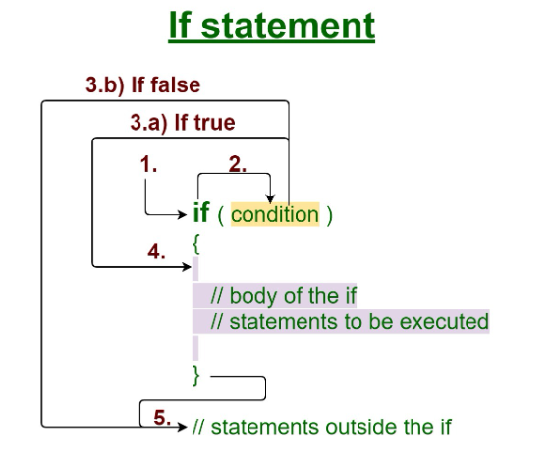
Working of if statement:
Control falls into the if block.
The flow jumps to Condition.
Condition is tested.
If Condition yields true, goto Step 4.
If Condition yields false, goto Step 5.
The if-block or the body inside the if is executed.
Flow steps out of the if block.
Operation: The condition after evaluation of
if-statement will be either true or false.
The if statement in Java accepts boolean values and
if the value is true then it will execute the block of statements under it.
Note: If we do not provide the curly braces ‘{‘ and ‘}’ after if( condition ) then by default if statement will consider the immediate one statement to be inside its block.

Slide 67
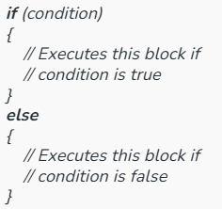
if-else Statement: The if-else statement in Java is a powerful decision-making tool used to control the program’s flow based on conditions. It executes one block of code if a condition is true and another block if the condition is false.
// Java Program to demonstrate if-else statement
public class IfElse {
public static void main(String[] args) {
int n = 10;
if (n > 5) {
System.out.println("The number is greater than 5.");
} else {
System.out.println("The number is 5 or less.");
}
}
}

Slide 68
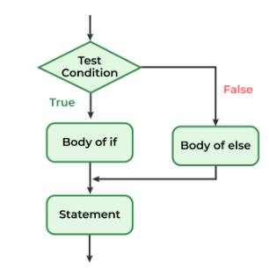
Working of if-else Statement
Control falls into the if block.
The flow jumps to the condition.
The condition is tested:
If the condition yields true, go to Step 4.
If the condition yields false, go to Step 5.
The if block or the body inside the if is executed.
If the condition is false, the else block is executed instead.
Control exits the if-else block.
In the above flowchart of Java if-else, it states that the condition is evaluated, and if it is true, the if block executes; otherwise, the else block executes, followed by the continuation of the program.

Slide 69
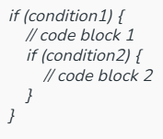
Nested if statement:
In Java, we can use nested if statements to create more complex conditional logic. Nested if statements are if statements inside other if statements.

Slide 70
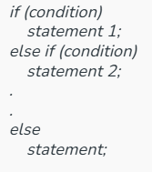
if-else-if ladder: The Java if-else-if ladder is used to evaluate multiple conditions sequentially. It allows a program to check several conditions and execute the block of code associated with the first true condition. If none of the conditions are true, an optional else block can execute as a fallback.
// Java program to demonstrate a simple if-else-if ladder
class Main {
public static void main(String[] args) {
int i = 20;
// if-else-if ladder to check the value of i
if (i == 10)
System.out.println("i is 10");
else if (i == 20)
System.out.println("i is 20");
else
System.out.println("i is neither 10 nor 20");
}
}

Slide 71
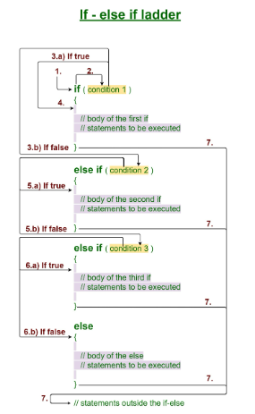
Working of the if-else-if ladder:
Control falls into the if block.
The flow jumps to Condition 1.
Condition is tested.
If Condition yields true, go to Step 4.
If Condition yields false, go to Step 5.
The present block is executed. Go to Step 7.
The flow jumps to Condition 2.
If Condition yields true, go to step 4.
If Condition yields false, go to Step 6.
The flow jumps to Condition 3.
If Condition yields true, go to step 4.
If Condition yields false, execute
else block. Go to Step 7.
Exit the if-else-if ladder.

Slide 72
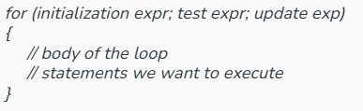
For Loop: Java for loop is a control flow statement that allows code to be executed repeatedly based on a given condition. The for loop in Java provides an efficient way to iterate over a range of values, execute code multiple times, or traverse arrays and collections.
Example:
class Main {
public static void main(String args[]) {
// for loop to print numbers from 1 to 5
for (int i = 1; i <= 5; i++) {
System.out.println("" + i);
}
System.out.println("Loop has ended.");
}
}

Slide 73
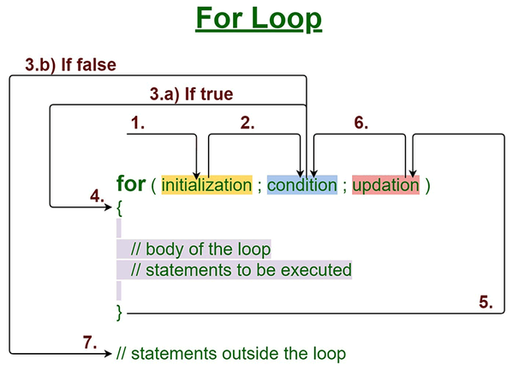
Working
Control enters the for loop.
Initialization is executed once at the beginning of the loop.
The Condition is evaluated:
If true, the control moves to Step 4.
If false, the control jumps to Step 7.
The body of the loop is executed.
Control moves to the Updation step.
After Updation, the flow returns to the
Condition (Step 3) and repeats the
process.
Once the condition becomes false, the control exits the for loop, and
statements outside the loop are executed.

Slide 74
Java for loop is divided into various parts as mentioned below:
Initialization Expression
Test Expression
Update Expression
1. Initialization Expression
Initializes the loop variable. This is executed once at the start of the loop.
Example:
int i = 1;
2. Test Expression
Tests the loop condition. If true, the loop body is executed; otherwise, the loop terminates.
Example:
i <= 10
3. Update Expression
After executing the loop body, this expression increments/decrements the loop variable by some value.
Example:
i++;

Slide 75
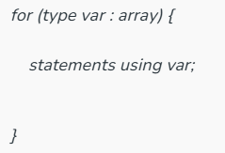
For-each loop: The for-each loop in Java (also called the enhanced for loop) was introduced in Java 5 to simplify iteration over arrays and collections. It is cleaner and more readable than the traditional for loop and is commonly used when the exact index of an element is not required.
// Java Program to Iterate through an array Using for-each loop
import java.io.*;
class ForEach {
public static void main(String[] args) {
// Array declaration
int arr[] = { 1, 2, 3, 4, 5 };
// Using for-each loop to
// print each element
for (int e : arr) {
System.out.print(e + " ");
}
}
}
Parameters:
type: The data type of the elements in the array or collection.
var: The variable that holds the current element during each iteration.
array: The array or collection being iterated over.

Slide 76
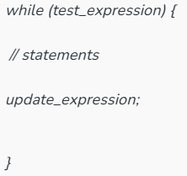
while Loop: Java while loop is a control flow statement used to execute the block of statements repeatedly until the given condition evaluates to false. Once the condition becomes false, the line immediately after the loop in the program is executed.
Example:
public class WhileLoop {
public static void main(String[] args) {
// Initialize the counter variable
int c = 1;
// While loop to print numbers from 1 to 5
while (c <= 5) {
System.out.println(c);
// Increment the counter
c++;
}
}
}

Slide 77
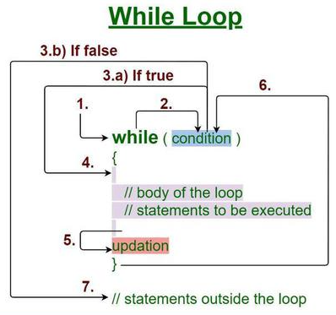
Working:
Control enters the while loop.
The condition is tested.
If true, execute the body of the loop.
If false, exit the loop.
After executing the body, update the loop variable.
Repeat from step-2 until the condition is false.

Slide 78
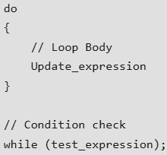
Do While Loop: ava do-while loop is an Exit control loop. Unlike for or while loop, a do-while check for the condition after executing the statements of the loop body.
// Java program to show the use of do while loop
public class DoWhile{
public static void main(String[] args) {
int c = 1;
// Using do-while loop
do {
System.out.println(“Hello: " + c);
c++;
} while (c <= 5);
}}
Practical Application of Do While Loop
Suppose you are implementing a game where you show some options to the user, press 1 to do this .., press 2 to do this .. etc and press ‘Q’ to quit the game. So here you want to show the game menu to the user at least once, so you write the code for the game menu inside the do-while loop.

Slide 79
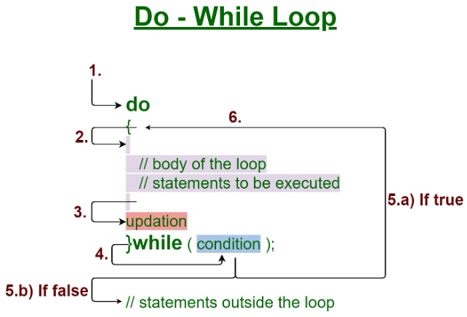
Execution of do-While loop
Control falls into the do-while loop.
The statements inside the body of the loop
get executed.
3. Updation takes place.
4. The flow jumps to Condition
5. Condition is tested.
If Condition yields true, go to Step 6.
If Condition yields false, the flow goes
outside the loop
The flow goes back to Step 2.
Components of do-while Loop
A. Test Expression: In this expression, we have to test the condition. If the condition evaluates to true then we will execute the body of the loop and go to update expression. Otherwise, we will exit from the while loop. For example: i <= 10
B. Update Expression: After executing the loop body, this expression increments/decrements the loop variable by some value. For example: i++;

Slide 80
Break Statement: The Break Statement in Java is a control flow statement used to terminate loops and switch cases. As soon as the break statement is encountered from within a loop, the loop iterations stop there, and control returns from the loop immediately to the first statement after the loop.
// Java Program to Illustrate break statement
import java.io.*;
class Test {
public static void main (String[] args) {
int n = 1; //assigning n as integer value
switch(n) { //passing n to switch it will check n and display output accordingly
case 1:
System.out.println(“Test");
break;
case 2:
System.out.println("Second Case");
break;
default:
System.out.println("default case");
} } }

Slide 81
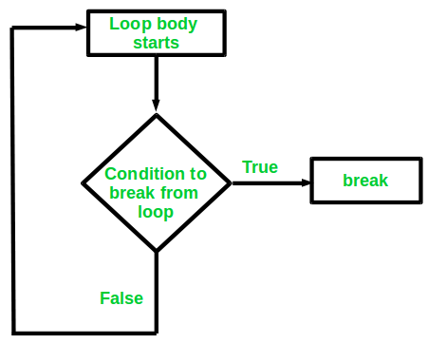
Syntax of break Statement: The break statements are used in situations when we are not sure about the actual number of iterations for the loop or we want to terminate the loop based on some condition.
break;
Working of Break Statement in Java:
In a switch statement: The break exits the switch block and prevents any further cases from being executed once a case is matched.
In a loop: The break statement terminates the loop execution, and control passes to the next statement after the loop.
The break statement can also be used in a labeled block (also referred to as the “goto” equivalent) to exit from nested blocks.

Slide 82
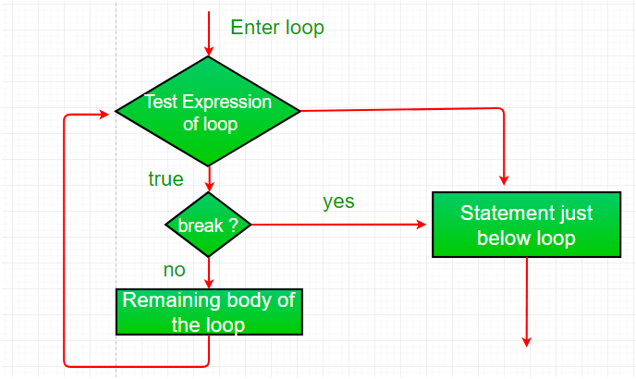
Using Break to Exit a Loop
Using break, we can force immediate termination of a loop, bypassing the conditional expression and any remaining code in the body of the loop.
Note: Break, when used inside a set of nested loops, will only break out of the innermost loop.

Slide 83
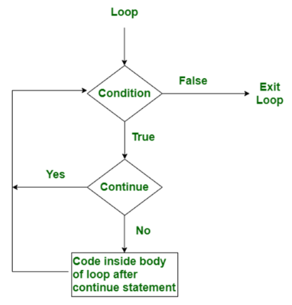
Continue Statement: In Java, the continue statement is used inside the loops such as for, while, and do-while to skip the current iteration and move directly to the next iteration of the loop.
// Java Program to illustrate the use of continue statement
public class Test
{
public static void main(String args[])
{
// For loop for iteration
for (int i = 0; i <=5; i++)
{
// Check condition for continue skip the
//execution of loop when i==3
if (i == 3)
continue;
System.out.print(i + " ");
}
}
}

Slide 84
When Continue Statement Used in Java?
The continue statement is used when we want to skip a particular condition and continue the rest execution. Some Points to consider while using Continue statements are mentioned below:
Java continue statement is used for all types of loops but it is generally used in for, while, and do-while loops.
In the case of a for loop, the continue keyword forces control to jump immediately to the update statement.
Whereas in the case of a while loop or do-while loop, control immediately jumps to the Boolean expression.

Slide 85
1. Continue Statement Inside Java While Loop: In the below program, we give an example, of how to use the continue statement within the While loop.
// Java Program to illustrate the use of continue statement inside the While loop
public class Geeks
{
public static void main(String args[])
{
int c = 0;
// While loop for iteration
while (c <= 5)
{
// Continue used when c==3
if (c == 3)
{
c++;
continue;
}
System.out.print(c + " ");
c++;
} } }

Slide 86
2. Continue Statement Inside Do While Loop: In the below program, we give an example, of how to use the continue statement within the do-While loop.
// Java Program to illustrate the use of continue statement inside the Do-While loop
import java.util.*;
public class Geeks
{
public static void main(String[] args)
{ int i = 0;
do // Do-While loop for iteration
{
if (i == 3) // Continue Statement used when i is equal to 3
{ i++;
continue;
}
System.out.print(i+" ");
i ++;
} while (i <= 5); // Condition check
} }

Slide 87
3. Continue Statement Inside Inner Loop(Nested Loop): In the below program, we give an example, of how to use the continue statement within Nested loops.
// Java Program to illustrate the use of continue statement inside an inner loop or simply nested loops
import java.util.*;
public class Main
{
public static void main(String[] args)
{
// Outer loop for iteration
for (int i = 1; i <= 4; i++)
{
// Inner loop for iteration
for (int j = 1; j <= 3; j++)
{
// Continue statement in inner loop to
// skip the execution when i==3
if (i == 3 && j==2)
{
continue;
}
System.out.print(i+"."+j+" ");
}
System.out.println();
}
}
}

Slide 88
return Keyword: return keyword in Java is a reserved keyword which is used to exit from a method, with or without a value. The usage of the return keyword can be categorized into two cases:
Methods returning a value
Methods not returning a value
1. Methods Returning a Value: For the methods that define a return type, the return statement must be immediately followed by a return value.
// Java Program to Illustrate Usage of return Keyword
class Test {
// Method to calculate average
double avg(double x, double y) {
double res = (x + y) / 2.0;
return res; // Return the calculated result
}
// Main driver method
public static void main(String[] args) {
System.out.println(new Test().avg(5.5, 6.5));
}
}
Explanation: In the above example, when the method avg is called, it computes the average of the inputs and returns the result, which is printed to the console.

Slide 89
2. Methods Not Returning a Value: For methods that do not return a value, the return statement can be skipped. This case can be further divided into two scenarios:
Method Without return in a void Function
Methods With void Return Type
Example 1: Method Without return in a void Function
// Java program to illustrate no return
// keyword needed inside void method
class Test {
// Method to calculate a reduced sum
void calc(int a, int b) {
int res = (a + b) / 10;
System.out.println(res);
}
// Main driver method
public static void main(String[] args) {
new Test().calc(5, 5);
System.out.println("No return keyword is used, and program executed successfully");
}
}
Note: Return statement not required (but can be used) for methods with return type void. We can use “return” which means not return anything.

